Slide 1
A beginner’s guide to Data Analytics: Course Intro + Bootstrap Notions!
Damian A. Tamburri, Ph.D.

Slide 2
4 Lessons Learned from last Lecture
We play the role of the Stakeholder for Data/AI Engineer (it’s all about the data anyway);
We work for a healthcare business (or a mission, or a domain, etc.) ➔ first we look for requirements from that aimed at intelligence;
Analytics are cool with AI nowadays but there’s more methods (e.g., metaheuristics) that are more fit with specific domains;
We start with EDA (exploratory data analysis), visualizations and stats can help;

Slide 3
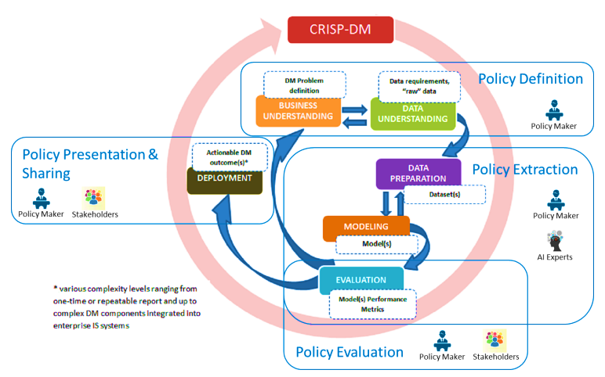
CRISP-DM from a BI Perspective

Slide 4
1. Data Generation & Collection (The Raw Inputs)
Clinical & Imaging
Structured and heavy unstructured clinical health history.
• EHRs & Epic Systems logs
• DICOM Medical Imaging (MRI/CT)
• Complex Genomic Sequencing (FASTA)
IoT & Remote Streams
Continuous high-frequency streams from patients.
• Continuous ICU bedside monitors
• Consumer Wearables (Apple Watch)
• Smart patches & remote pacemakers
Operational & Claims
Administrative records tracking transactional actions.
• Insurance claim codes (ICD-10)
• Pharmacy prescription records
• Hospital check-in/discharge logs

Slide 5
Main steps in a BI/Data Analytics Project
Define the goals:
  Business and data mining experts together have to define the goals;
  Each goal must be defined with measurements for success;
Obtain the models:
  Apply data mining algorithms;
  Preprocessing is important!
Evaluate results:
  ascertain the value of an object according to specified criteria, operationalised in terms of pre-specified measures;
Deploy:
  Decide patterns and models that can be deployed;

Slide 6
1. Define the goals
Distinguish between :
  Data Mining goals
  Business goals
How do we translate?
Increase the lifetime value of valuable customers
¿?
¿?
¿?
Classification
Estimation
Association

Slide 7
Business Understanding in the CRISP-DM* Process
Business Understanding
Determine Business Objectives
Background
Business Objectives
Business Success Criteria
Assess Situation
Inventory & Resources
Reqs, Assumptions &Constraints
Risks & Contingencies
Terminology
Costs & Benefits
Determine Data Mining Goals
Data Mining Goals
Data Mining Success Criteria
Produce Project Plan
Project Plan
Initial Assessment of Tools & Techniques
* Cross-Industry Standard Process for Data Mining:CRISP-DM

Slide 8
1.1 Determine Business objectives and success criteria
Not only business objectives have to be established but measures in order to be able to evaluate the results
Business objectives:
  What is the customer's primary objective?
    Increase the number of loyal customers
    Selling more of a certain product
    Have a positive marketing campaing
Business success criteria:
  What constitutes a successful outcome of the project?
  Objectives measures so that the success can be established
  ROI

Slide 9
1.2 Costs & Benefits
Perform a cost-benefits analysis
    Compute the benefits of the project
      Which measures do we have?
      ROI
      APEX
      OPEX....
    Compute the costs of the project (equipment, human resources...)
      Which methodology do we have?
      COCOMO for sortware engineering part
    Quantify the risk that the project fails
      Knowledge not available
      Data Not available
      Proper tools

Slide 10
Data Mining Estimation Model
Establishing a parametrical estimation model for Data Mining (Marban’03)
DMCOMO
(Data Mining COst MOdel)

Slide 11
Data Mining Cost Estimation
Main factors in a Data Mining project
  Data Sources (number, kind, nature, …)
  Data mining problem to be solved (descriptive, predictive, …)
  Development platform
  Available tools
  Expertise of the development team
Drivers
  Data Drivers
  Model Drivers
  Platform Drivers
  Tools and techniques Drivers
  Project Drivers
  People Drivers

Slide 12
1.3 Data Mining: Goals and Success
Data mining goals:
  Translate the customer's primary objective into a data mining goal, e.g.
    Loyalty program translated into segmentation problem
    Decreasing the attrition rate transformed into classification problem
Data mining success criteria:
  Determine success in technical terms
    Translate the notion of sucess into confidence, support and lift and other parameteres
    Determine de cost of errors
How do we make the translation?

Slide 13
Methodology
Which is the methodology to be followed to translate business objectives into data mining objectives?
Unluckily, there is no such methodology. First we have to solve:
  How a business objective is expressed?
  What is a data mining goal?
  How are data mining goals achieved?
  Which are the requirements of data mining functions?
In order to describe everything in a standard way:
Conceptualize the problem

Slide 14
Conceptualization in other disciplines
Data Bases:
  E/R diagrams
  Independent of the domain
  A tool for business understanding and for data base designer
  Translation from E/R to implementation
External view 1
External view n
Conceptual Schema
Internal Schema

Slide 15
3-level Architecture for DA
Business problem
Business problem
Requirements of algorithms will
be solved at this level
Conceptual Schema
Internal Schema
Tools requirements to be solved here
SAS, WEKA, Clementine…

Slide 16
Elements to conceptualize
Elements to be taken into account:
  Data:
    Quality from data mining point of view
    Adequateness for the problem
    Classification for data mining purposes
  Knowledge:
    Related to the process being analyzed
    Related to the data used
  People
    Owners of data
    Experts in the process
  Data mining problems requirements
  Data mining methods requirements

Slide 17
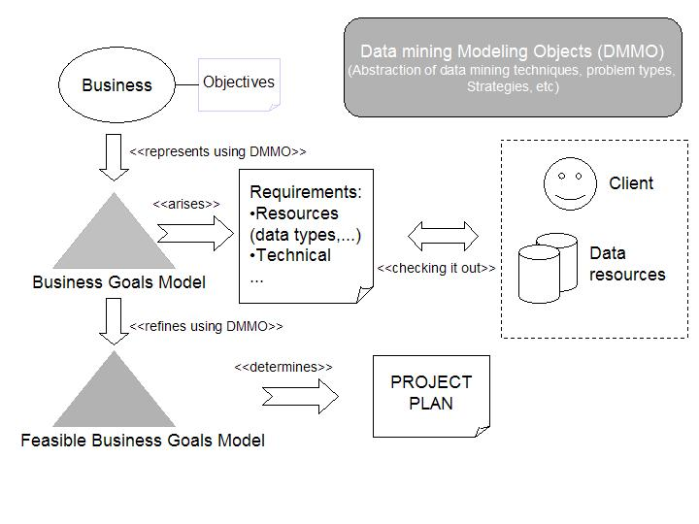
Proposed process

Slide 18
DAMO
Data Analytics Modelling Objects:
  Data
  Knowledge
  Constraints of data and applications
  Data Mining objects
    Algorithms
    Measures
    Methods
Bridge the gap between data miners and business users;

Slide 19
Is the data adequate for analysis?
The adequateness of the data is analyzed taking into account goals to fulfill;
Data & expert knowledge can be transformed so that just by being the input of a certain data mining algorithm will produce the required patterns;
Quality of the data, in this context:
  is not only related to the technical quality;
  proper model, percentage of null values;
  meaning of the attributes;
  Where each piece of data comes from;
  relationship among data;
  how the data fulfills data mining requirements

Slide 20
2. Data Mining == obtain models
Apply data mining process model
Associated problems solved by the 3 layers architecture:
  Comparison of approaches
  Evaluate costs
  Pros and cons of approaches
Only experience or a conceptualization can help
The conceptual model will help to establish the process to obtain each feasible model.
Requirements and transformations implicit in the model

Slide 21
2.1 Determine type of problem
  What are data mining problems?
    Classification
    Estimation
    Association
    Segmentation
  In the conceptual model requirements for each type will be settled
Notes:
what is needed to complete the puzzle

Slide 22
3. Evaluate results*
Evaluation: the act of ascertaining the value of an object according to specified criteria, operationalised in terms of measures;
  Object= model already obtained;
  Criteria and Measures and has to do with goals;
Evaluation requires a well-defined notion of success, which must be in place before
  the evaluation takes place
  the data mining phase starts
  any work with the data starts
i.e. already during the business understanding process;
Here once again conceptualization plays its role;
* [Spilipopou, Berendt]

Slide 23
Evaluation in the CRISP-DM Process
The CRISP-DM process is:
  a never-ending circle of iterations;
  a non-sequential process, where backtracking at previous phases is usually necessary;
In each sequential instantiation evaluation takes place:
But it is a cycle;
In all the iterations all the steps should be revisited;
Results have to be evaluated!!
Business Understanding
Business Understanding
Data Understanding
Data
Preparation
Modeling
Evaluation
Deployment

Slide 24
4. Deployment
All the models that have possitive evaluation can be deployed
For measurements of success to trust deployment has to follow rules established at the beginning of the project
  The real evaluation has not yet been performed

Slide 25
A quick example, Netflix!
Find recommendations for *all* customer profiles
Find opportunities for new series/movies...

Slide 26
A quick example, Netflix!
Find recommendations for *all* customer profiles
Find opportunities for new series/movies...

Slide 27
A quick example, Netflix!
Find recommendations for *all* customer profiles
Find opportunities for new series/movies...

Slide 28
Ratings Data
17,700 movies
1 | 3 | 4
 | 3 | 5 |  |  | 5
 |  | 4 | 5 |  | 5
 |  | 3
 |  | 3
2 |  |  | 2 |  | 2
 |  |  |  | 5
 | 2 | 1 |  |  | 1
 | 3 |  |  | 3
1
480,000
users

Slide 29
Rating Data
100 million ratings (matrix in prev slide is 99% sparse)
Rating = [user, movie-id, time-stamp, rating value]
Generated by users between Oct 1998 and Dec 2005
Users randomly chosen among set with at least 20 ratings
  Small perturbations to help with anonymity

Slide 30
A quick example, Netflix!
Find recommendations for *all* customer profiles
Find opportunities for new series/movies...

Slide 31
Ratings Data
17,700 movies
1 | 3 | 4
 | 3 | 5 |  |  | 5
 |  | 4 | 5 |  | 5
 |  | 3
 |  | 3
2 |  |  | ? |  | ?
 |  |  |  | ?
 | 2 | 1 |  |  | ?
 | 3 |  |  | ?
1
480,000
users
Test Data Set
(most recent ratings)

Slide 32
Ratings Data
17,700 movies
1 | 3 | 4
 | 3 | 5 |  |  | 5
 |  | 4 | 5 |  | 5
 |  | 3
 |  | 3
2 |  |  | ? |  | ?
 |  |  |  | ?
 | 2 | 1 |  |  | ?
 | 3 |  |  | ?
1
Hold on… what is this?
480,000
users
Test Data Set
(most recent ratings)

Slide 33
Meet the ML Canvas!

Slide 34
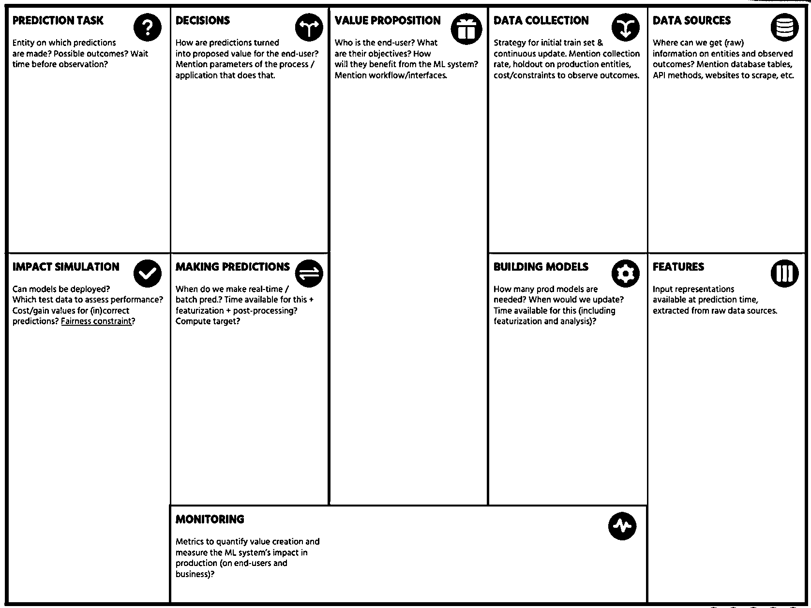

Slide 35

In Practice…
“Machine learning is about predicting the future based on the past.”
-- Hal Daume III

Slide 36
So, Machine Learning is about…
“Machine learning is about predicting the future based on the past.”
-- Hal Daume III
past
future
predict
learn
Training
Data
model/
predictor
Testing
Data
model/
predictor

Slide 37
Disclaimer! Data Analytics, a.k.a...
data mining: e.g., machine-learning applied to “databases”, i.e. collections of data
inference and/or estimation: ML in statistics to approximate curves based on more and more data
pattern recognition: ML to identify patterns in engineering
signal processing: same as above but in electrical engineering
Optimization: correct behavior based on previous experience

Slide 38
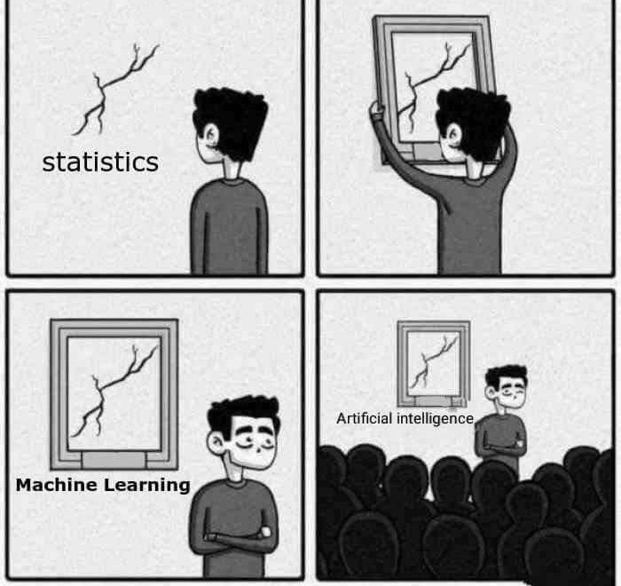
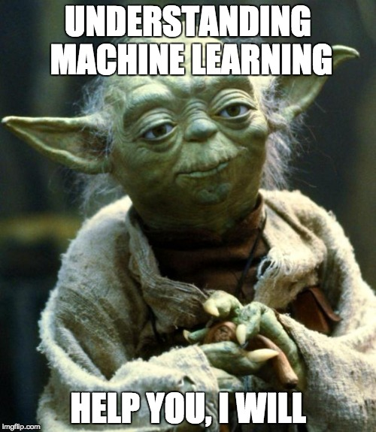
The best way to explain ML

Slide 39
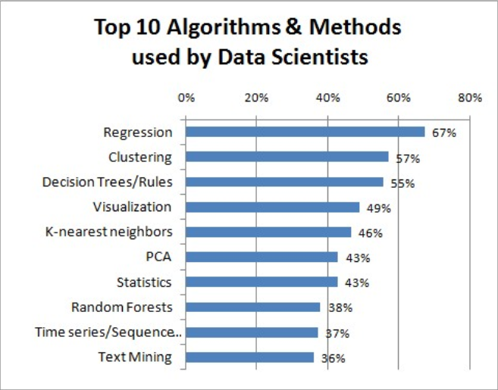
The best way to explain ML

Slide 40
Machine Learning, let’s dive in!
data mining: machine learning applied to “databases”, i.e. collections of data
inference and/or estimation: ML in statistics to approximate curves based on more and more data
pattern recognition: ML to identify patterns in engineering
signal processing: same as above but in electrical engineering
Optimization: correct behavior based on previous experience

Slide 41
Here’s a good question...
Assume you’re a regular human...
You’re iterating over and over again on the previous 3 exercises...
  What should be constant in your exercise?
  1.
  2.

Slide 42
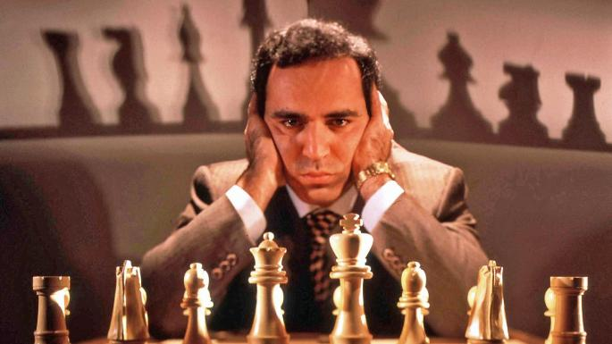
Here’s a good question...
Assume you’re a regular human...
  Meaning that you’re not THE Librarian, nor THE Doctor, nor Garry Kasparov…

Slide 43
Back to our exercise...
Assume you’re a regular human...
You’re iterating over and over again on the previous 3 exercises...
  What should be constant in your exercise?
  1.
  2.

Slide 44
Here’s a hint...
Natural lang.
vision
effectors
input
Knowledge
representation
learning
planning
reasoning

Slide 45
Here’s a good question...
Assume you’re a regular human...
You’re iterating over and over again on the previous 3 exercises...
  What should be constant in your exercise?
  1. Learning!
  2.
Create new knowledge by processing available data – new knowledge is to be checked against future instances of same phenomenon

Slide 46
Here’s a good question...
Assume you’re a regular human...
You’re iterating over and over again on the previous 3 exercises...
  What should be constant in your exercise?
  1. Learning!
  2. Improving!
Reduce the amount of errors made with respect to testing of created knowledge against new instances of same phenomenon

Slide 47
Here’s a good question...
Assume you’re a regular human...
You’re iterating over and over again on the previous 3 exercises...
  What should be constant in your exercise?
  1. Learning!
  2. Improving!
When you’re doing it, it’s Human Learning...

Slide 48
Here’s a good question...
Assume you’re a regular human...
You’re iterating over and over again on the previous 3 exercises...
  What should be constant in your exercise?
  1. Learning!
  2. Improving!
When you’re doing it, it’s Human Learning...
When a machine does it, it’s Machine Learning! ☺

Slide 49
In summary…
Assume you’re a regular human...
You’re iterating over and over again on the previous 3 exercises...
  What should be constant in your exercise?
  1. Learning!
  2. Improving!
Use clever strategies and algorithms, combine them with good data and statistics

Slide 50
In summary…
Assume you’re a regular human...
You’re iterating over and over again on the previous 3 exercises...
  What should be constant in your exercise?
  1. Learning!
  2. Improving!
Use clever statistical indices (F-Measure, AUC-ROC) to measure the overlaps between ML prediction and expected result

Slide 51
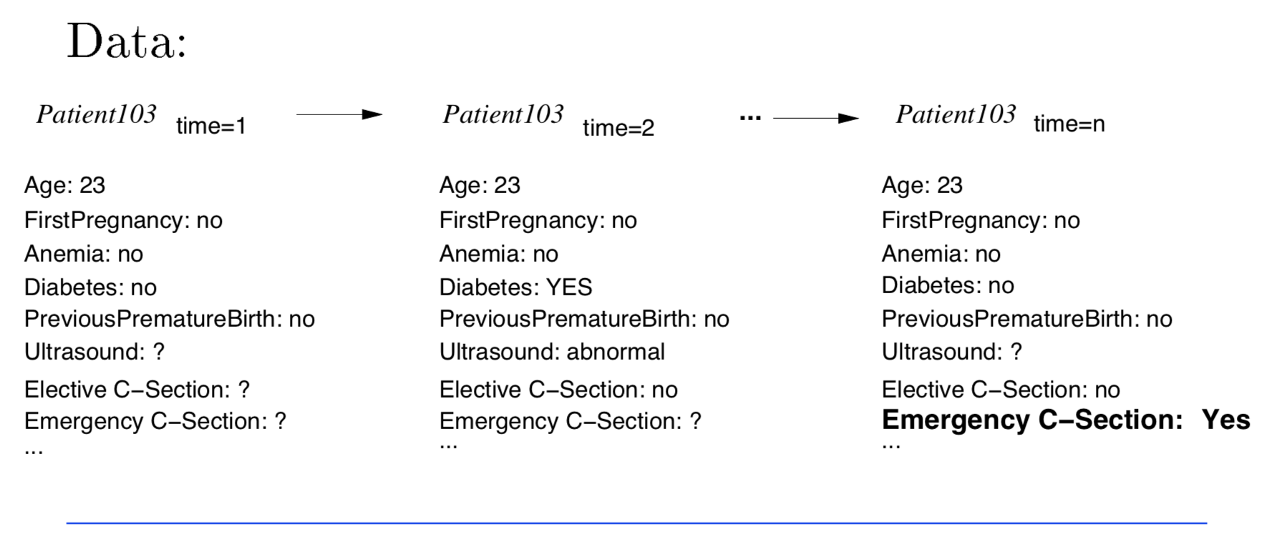
Typical Data-Mining Task
Medical records

Slide 52
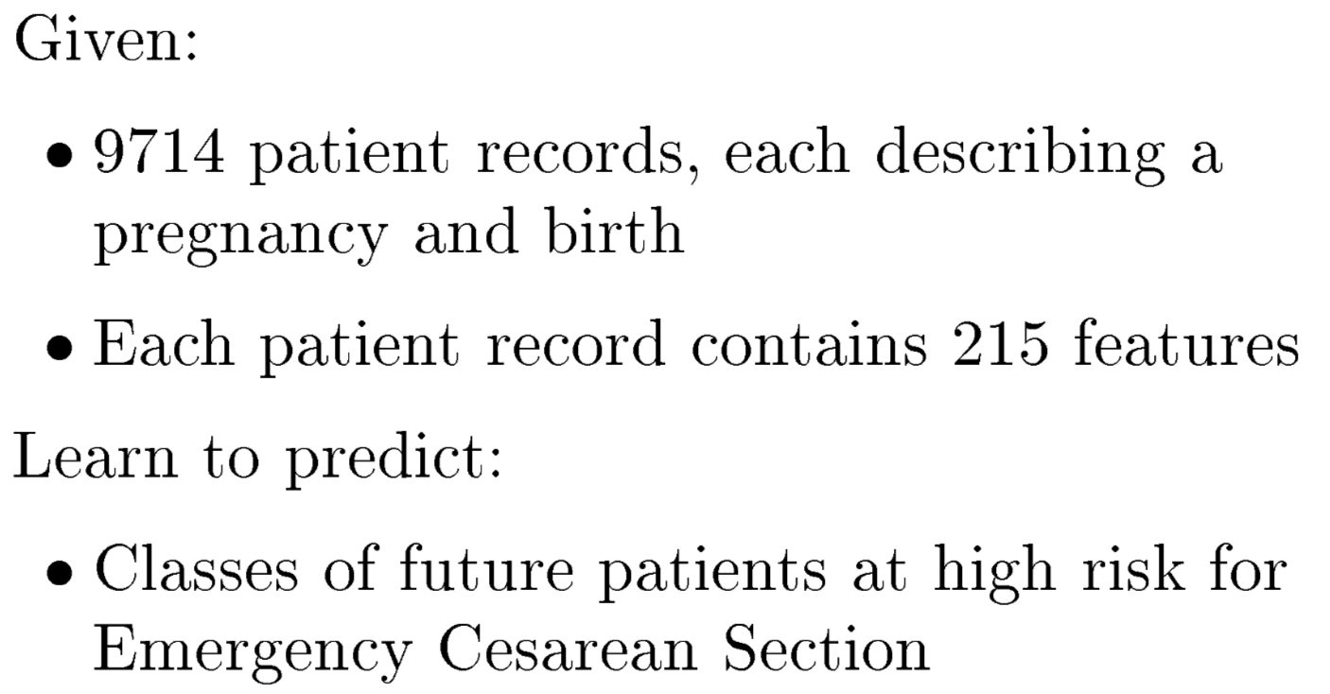
ML Task involved in this case…
* ML Task *

Slide 53
Back to our Examples...
C-Section “Learning” == Text Classification!
  Task T
    Assigning medical texts to a set of predefined risk categories
  Performance measure P
    Precision and recall of each category
  Training experiences E
    A database of texts with their corresponding categories

Slide 54
First, let’s take a step back...
C-Section “Learning” == Text Classification!
  Task T
    Assigning medical texts to a set of predefined risk categories
  Performance measure P
    Precision and recall of each category
  Training experiences E
    A database of texts with their corresponding categories
How about Disease Diagnosis?
How about Chess Playing?
...

Slide 55
Unranked evaluation:
Precision and Recall
Sec. 8.3
Precision: fraction of retrieved docs that are relevant = P(relevant|retrieved)
Recall: fraction of relevant docs that are retrieved
= P(retrieved|relevant)
Precision P = tp/(tp + fp)
Recall R = tp/(tp + fn)
 | Relevant | Nonrelevant
Retrieved | tp | fp
Not Retrieved | fn | tn
Notes:
Evaluation in information-retrieval
Other techniques and intro here: http://www.ics.uci.edu/~djp3/classes/2008_01_01_INF141/Lectures/Slides26.pdf

Slide 56
A combined measure: F
Sec. 8.3
Combined measure that assesses precision/recall tradeoff is F measure (weighted harmonic mean):
People usually use balanced F₁ measure
  i.e., with β = 1 or α = ½
Harmonic mean is a conservative average
  See CJ van Rijsbergen, Information Retrieval
Notes:
https://en.wikipedia.org/wiki/Harmonic_mean

Slide 57
F₁ and other averages
Sec. 8.3

Slide 58
Recap
ML (and in general, AI) constitutes “the study of how to make computers do things at which, at the moment, people are better”;
CRISP-DM is a model to structure the data-mining process behind, before, and after ML;
Different models exist and different approaches can be used…
  the Data Scientist builds and executes a research agenda towards a proper experimentation;
  the Data Engineer elicits a plan to obtain/curate/govern the data and eventually deploy/maintain/evolve the model;

Slide 59
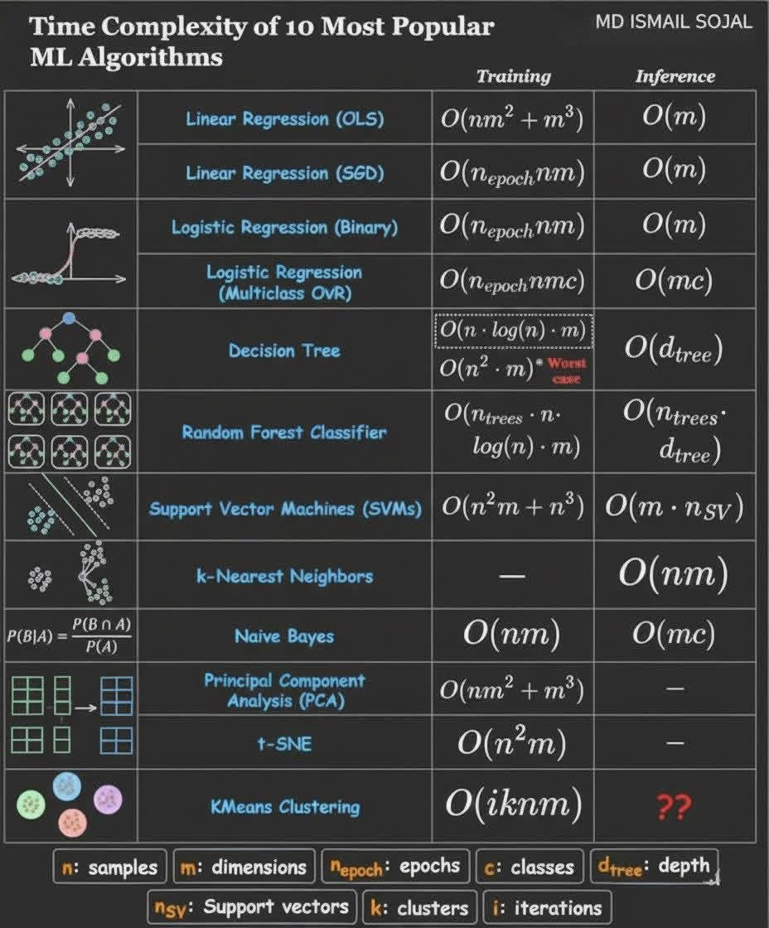

Slide 60
Core Challenges in the Analytics Pipeline
1. Strict Privacy & Compliance Regulations: Systems must follow rigorous compliance rules (HIPAA in the US, GxDPR in Europe). Moving medical records to standard data networks requires absolute end-to-end encryption and anonymization protocols.
2. Extreme Interoperability Gaps: Different regional hospital branches and legacy lab hardware use non-uniform formatting schemas. Aggregating them requires tedious ETL (Extract, Transform, Load) formatting phases.
3. High Computational Load: Running immediate predictive algorithms on high-fidelity genomic sequencing strings or real-time continuous ICU metrics demands heavy, costly server and cloud hardware architectures.

Slide 61

Questions?

